Slide 1
Power BI apps on Business Central environment/app telemetry
May 2023 release

Slide 2
Long running AL telemetry now has suspended time
Partners feedback: event RT0018 does not provide value since it included time spent in modal events.
Therefore, we added the time where the measurement was suspended so that partner telemetry users can filter the modal ones away.

Slide 3
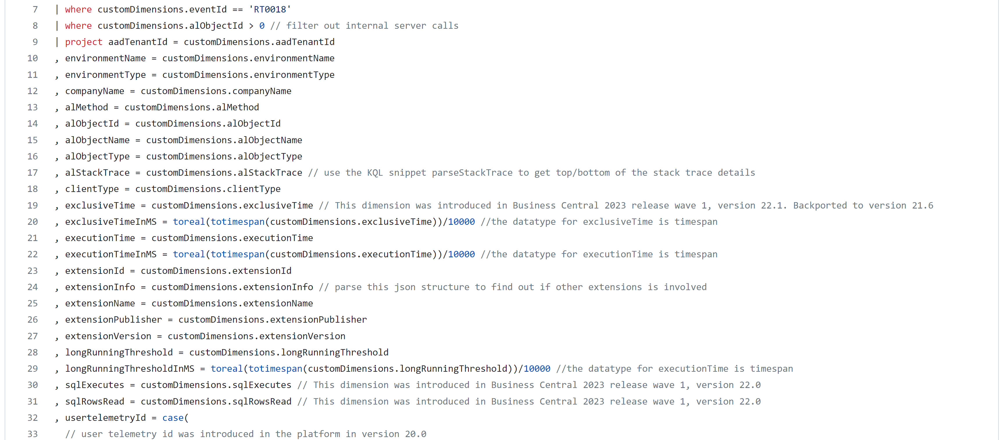
New dimension - exclusiveTime

Slide 4
Analyze report rendering time
renderTime = totalTime-serverExecutionTime
Now documented on docs
Added to KQL samples
Shown in (both) PBI apps

Slide 5
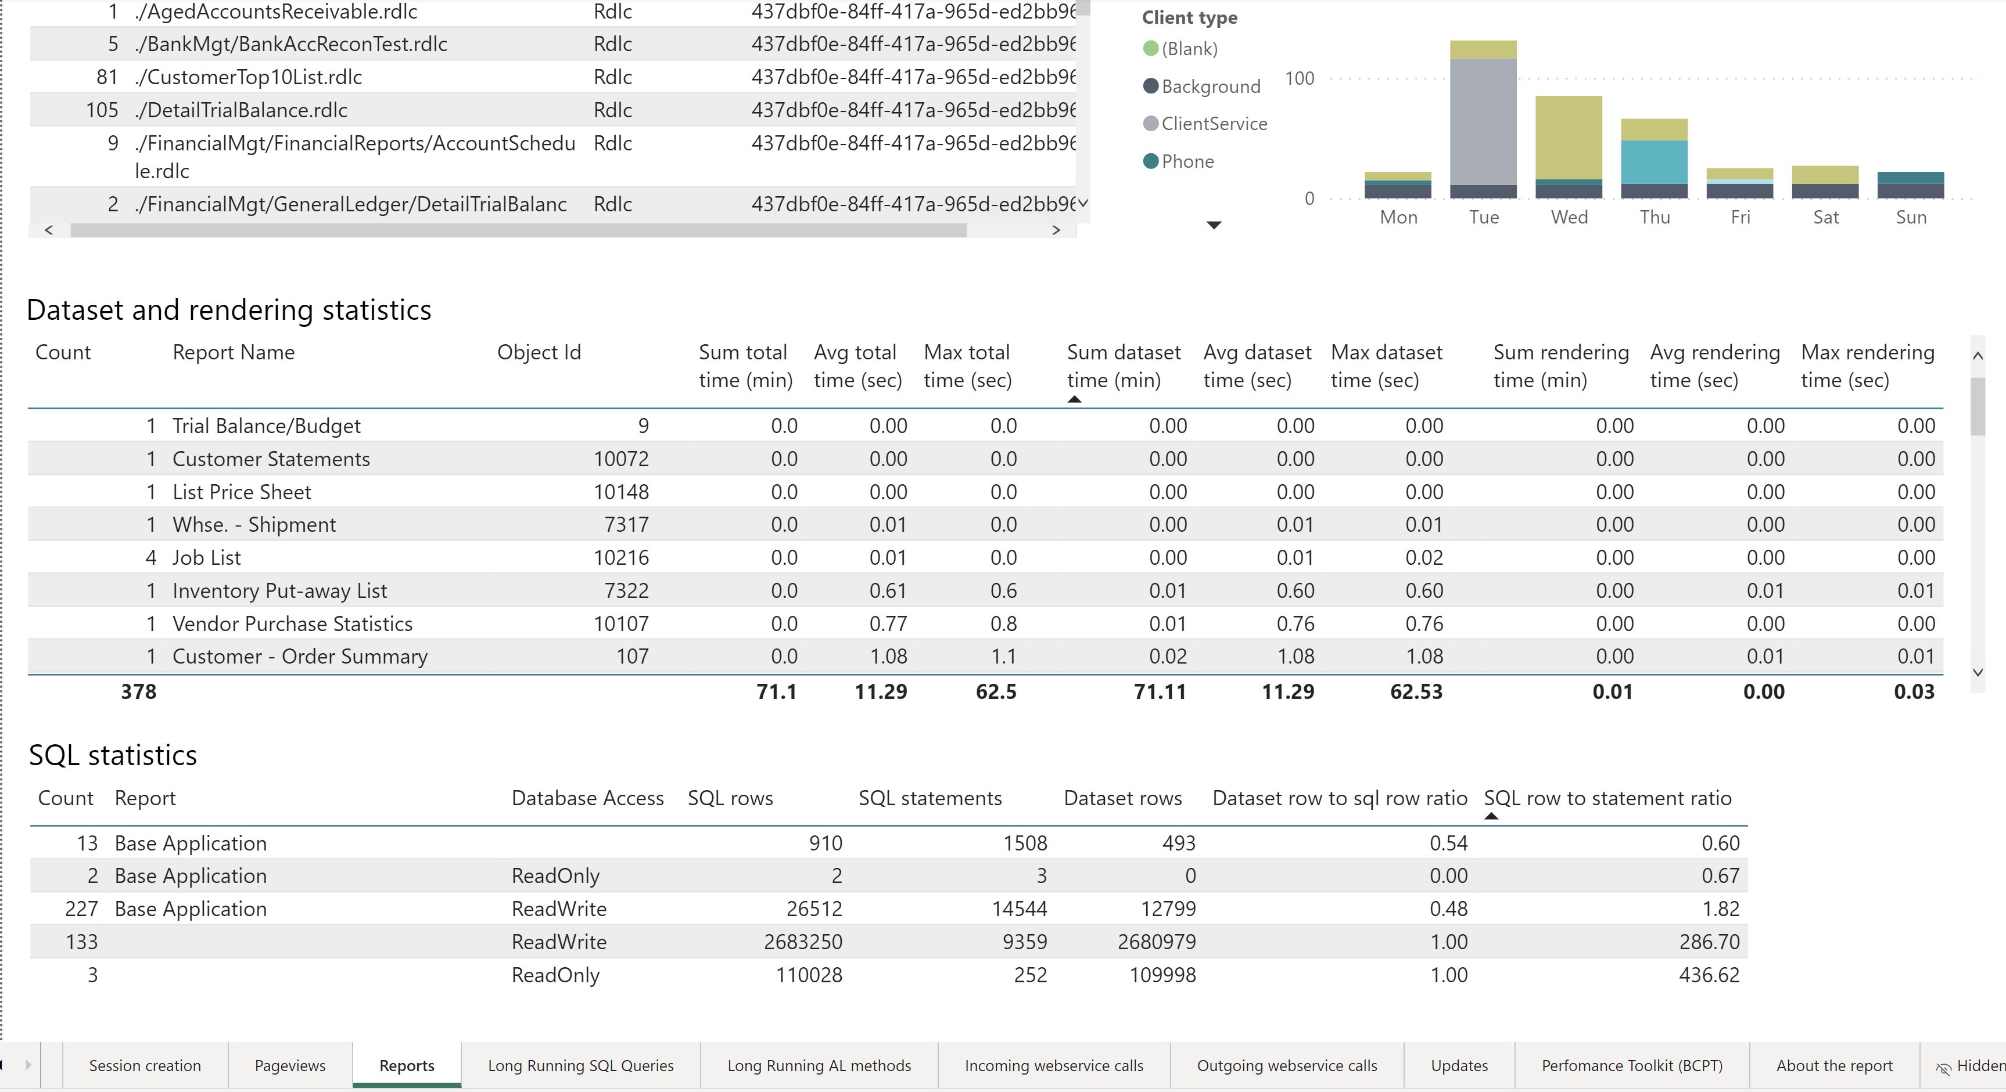
Report rendering statistics shown in PBI apps

Slide 6
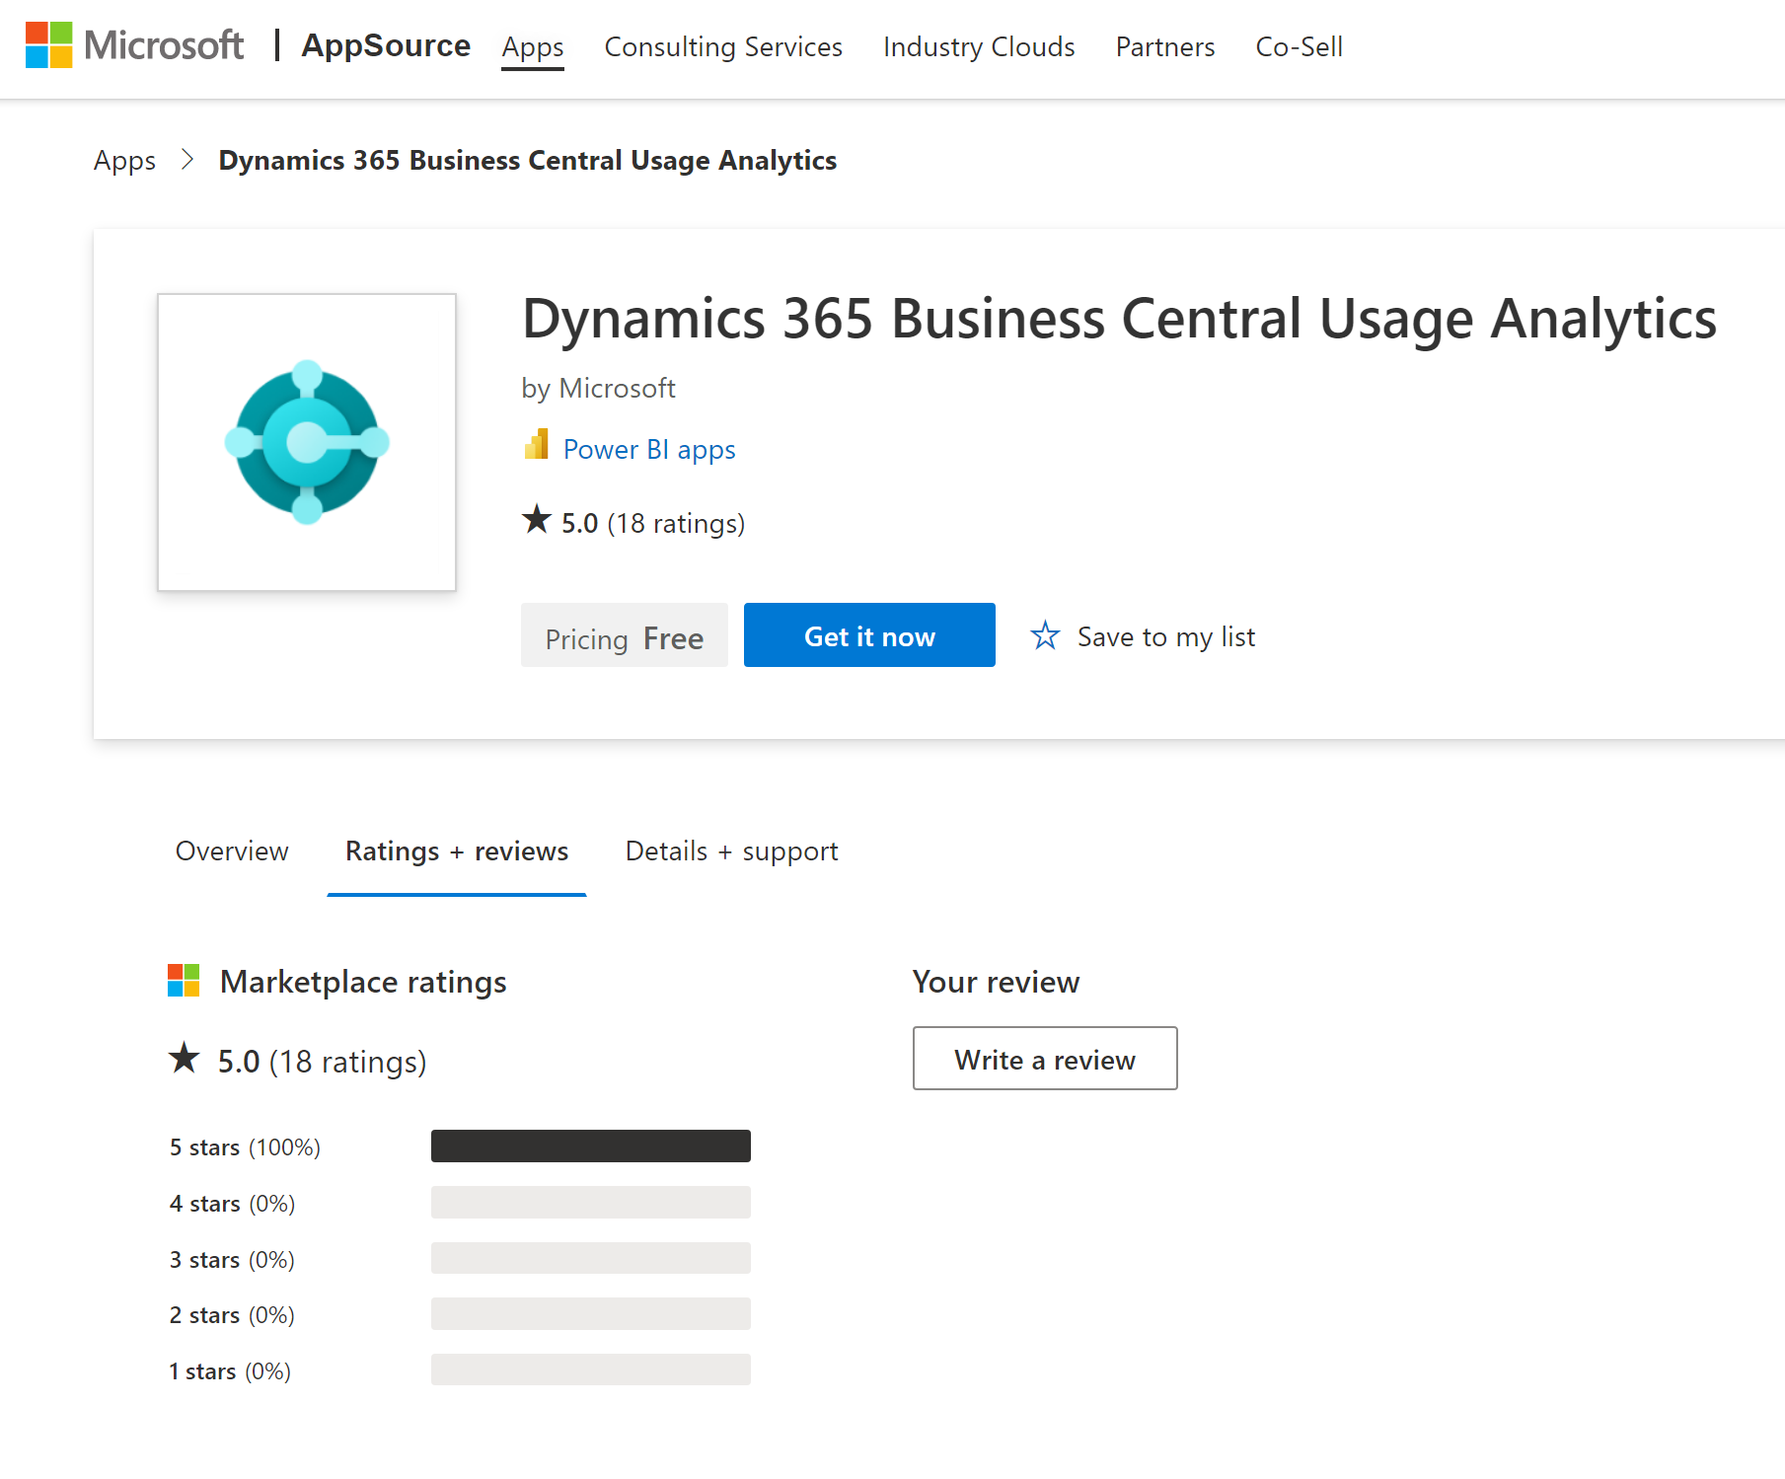
Install/update from Appsource (available now)

Slide 7
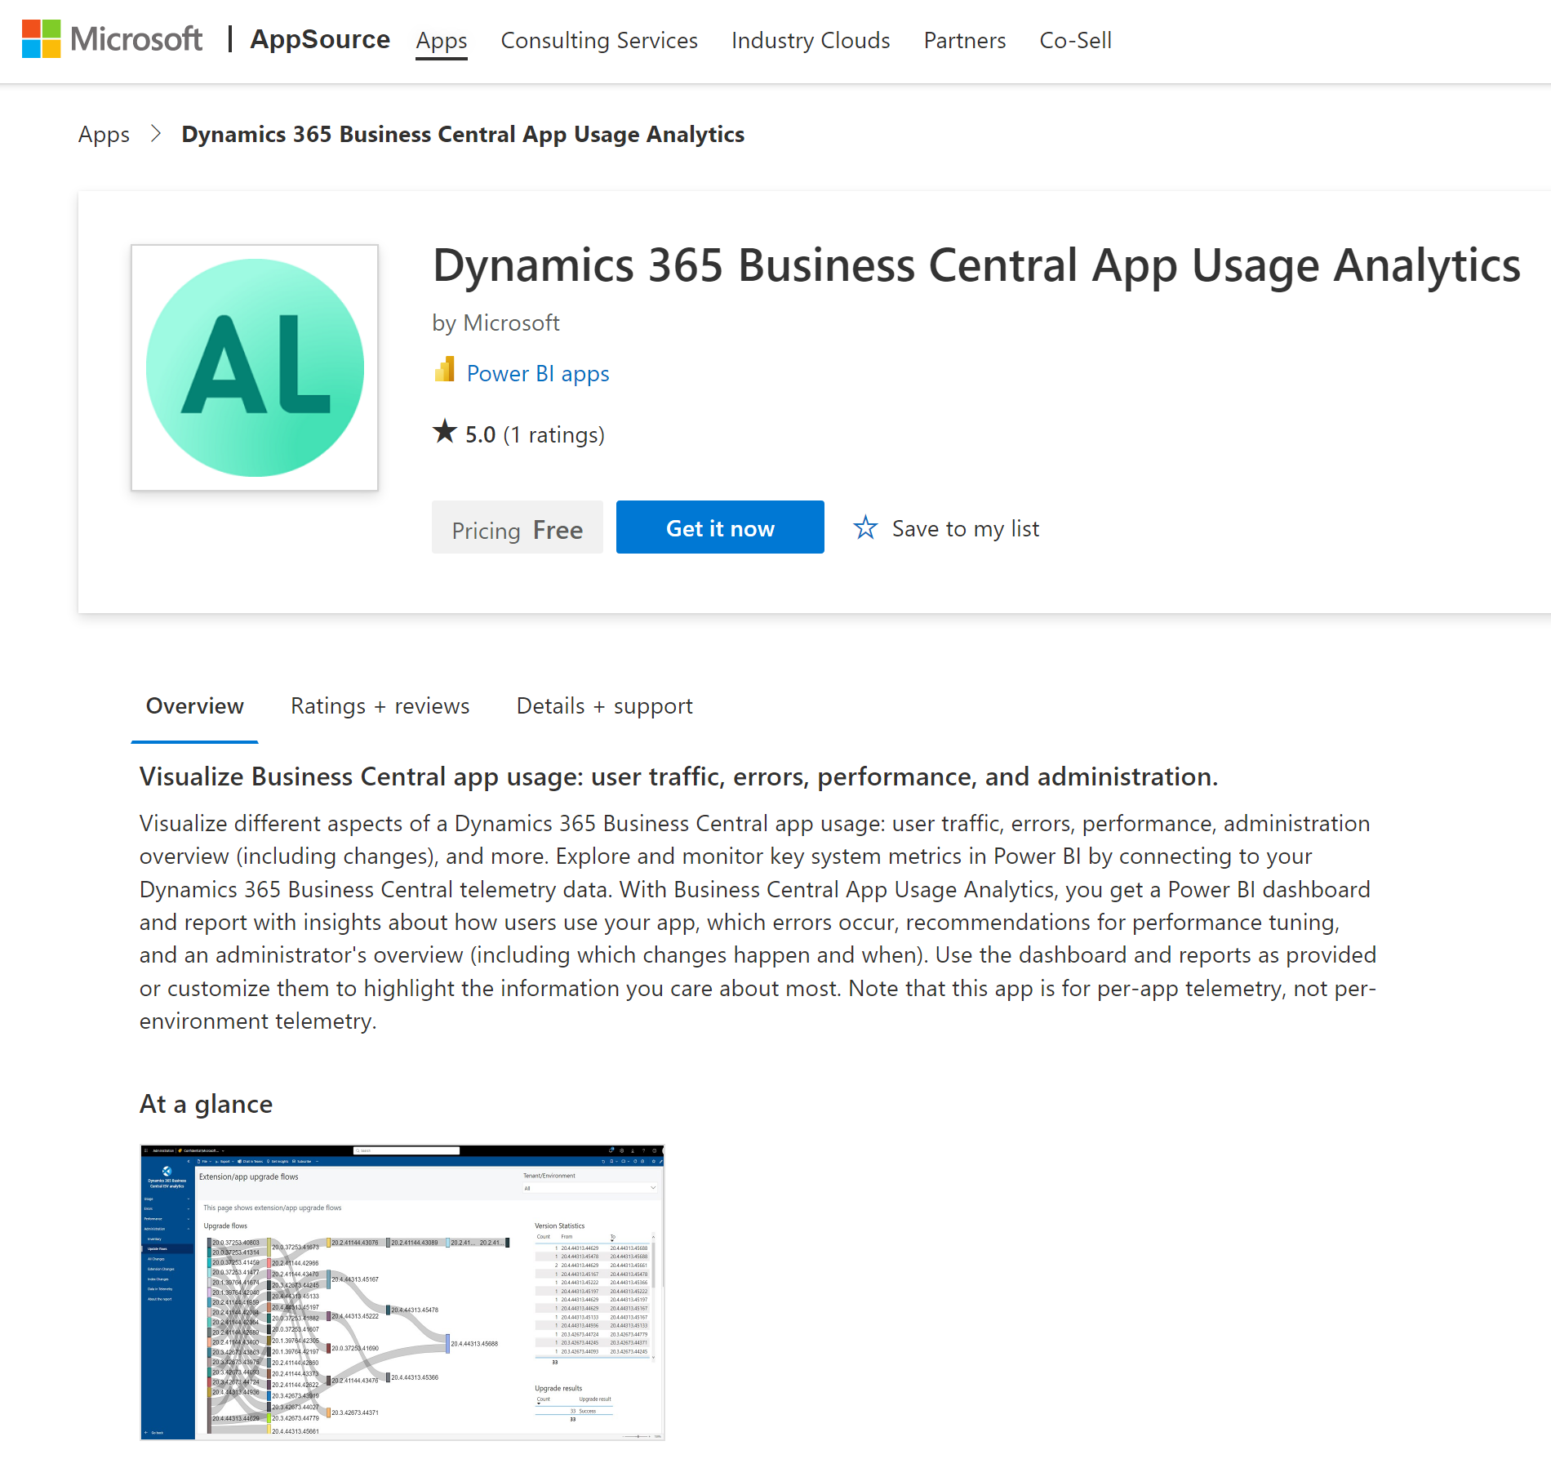
Install/update from Appsource (available now)

Slide 8
